Slide 2

Your Name
Your Role, Your Company
Interesting Fact

Slide 4
Chapter Goals
Introduction to Infrastructure as Code
Provision to Azure
Basic Blocks of Terraform
Fire It Up!
Quiz

Slide 5
Introduction

Slide 6
What is Infranstructure as Code
Infrastructure as Code (IaC) is the process of managing and provisioning computer data centers through machine-readable definition files.

Slide 7
Infrastructure as Code
Provide a codified workflow to create infrastructure
Expose a workflow for managing updates to existing infrastructure
Integrate with application code workflows (Git, SCM, Code Review)
Provide modular, sharable components for separation of concerns

Slide 8
Provisioning a Virtual Machine
Name
Operating System (Image)
Size
Location
Username and Password

Slide 9
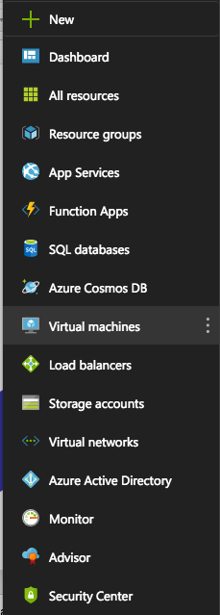
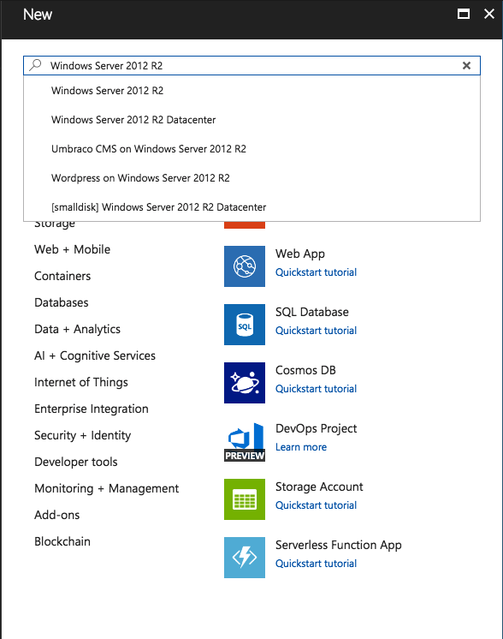

Slide 10
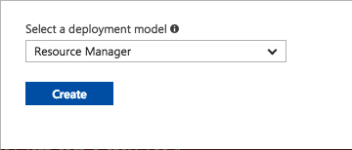

Slide 11
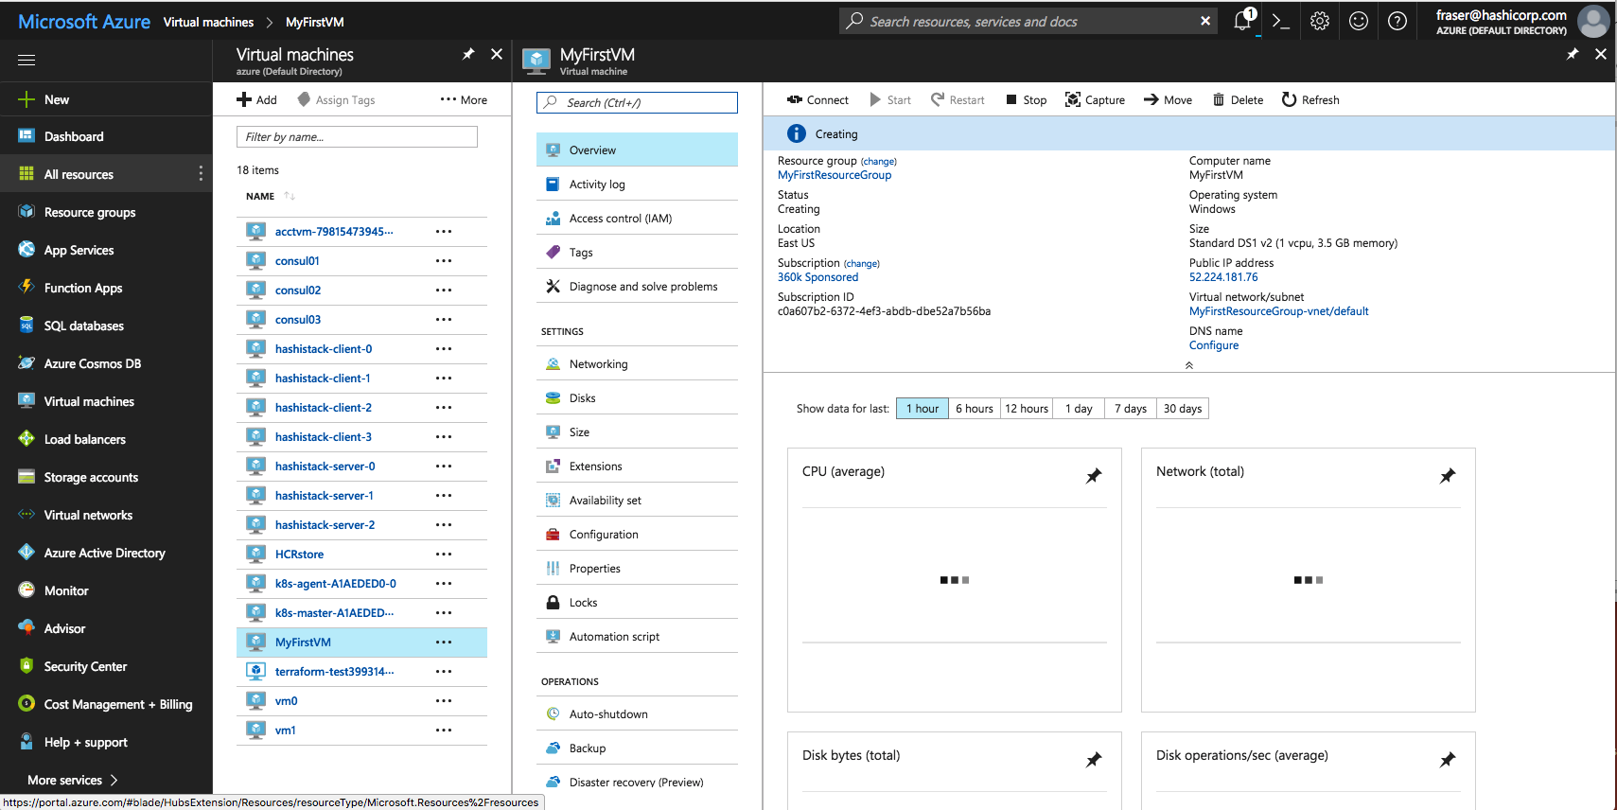

Slide 12
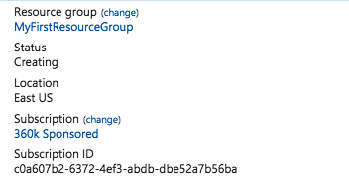
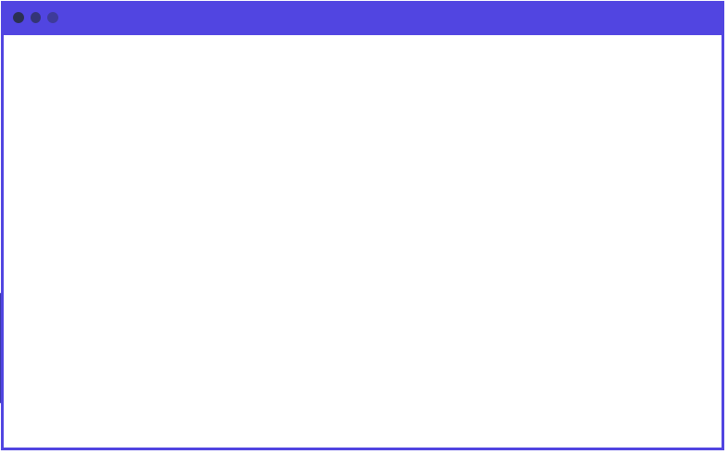
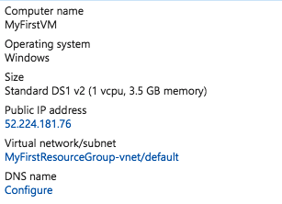
main.tf
resource ”azure_instance” “web” {
name = “MyFirstVM”
image = “Windows 2012 R2”
size = “Standard DS1”
location = “East US”
username = “John Doe”
password = “Iamrootfearme!”
}

Slide 13
main.tf
resource ”azure_instance” “web” {
name = “MyFirstVM”
image = “Windows 2012 R2”
size = “Standard DS1”
location = “East US”
username = “John Doe”
password = “Iamrootfearme!”
}

Slide 14
What is Terraform
Terraform is a tool for building, changing, and versioning infrastructure safely and efficiently.

Slide 15
Terraform and Infrastructure as Code
Infrastructure is described using a high-level configuration syntax. This allows a blueprint of your datacenter to be versioned and treated as you would any other code. Additionally, infrastructure can be shared and re-used.

Slide 16
Infrastructure as Code (Terraform)
Human-readable configuration (HCL) is designed for human consumption so users can quickly interpret and understand their infrastructure configuration.
HCL includes a full JSON parser for machine-generated configurations.

Slide 17

Azure - Resource Group
A container (not that container) that holds related resource for an Azure solution;
The resource group can include all resources for the solution or only those you want to manage as a group
You decide how you want to allocate resources to resource groups based on what makes sense for you!

Slide 18
Azure - Resource
A manageable item that is available through Azure. Some common resources are;
Virtual machine
Storage Account
Virtual Network/Subnet

Slide 19
Workstation Setup

Slide 20
Exercise: Install Terraform
Download the Terraform binary for Windows 64-bit
Create a directory at C:\bin (or wherever you like)
Unzip the Terraform binary into C:\bin
Add C:\bin to your system path variable

Slide 21
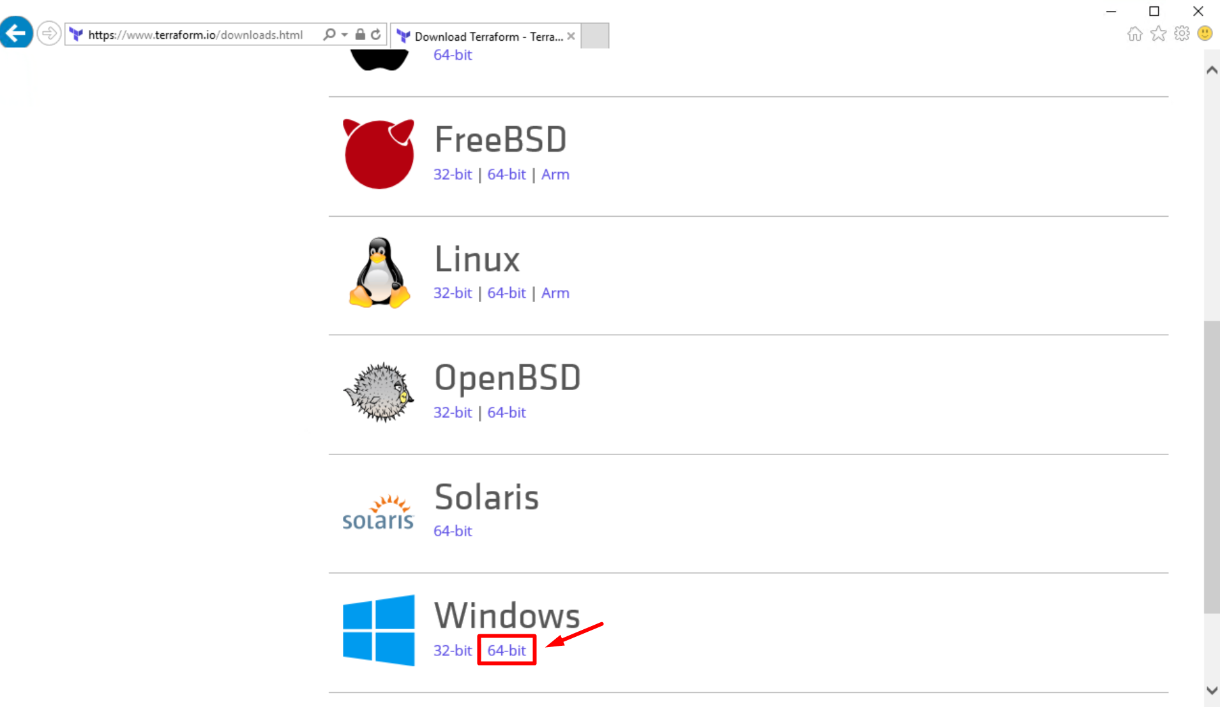
Step 1: Download Terraform
https://terraform.io/downloads.html
Notes:
Make sure and download the 64 bit version for Windows. Terraform is shipped as a single binary, inside of a zip archive.

Slide 22
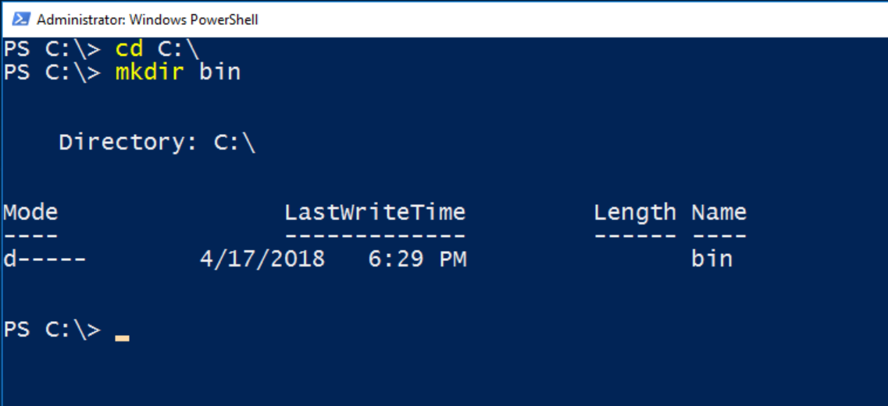
Step 2: Create a bin directory
Notes:
Make sure and download the 64 bit version for Windows. Terraform is shipped as a single binary, inside of a zip archive.

Slide 23
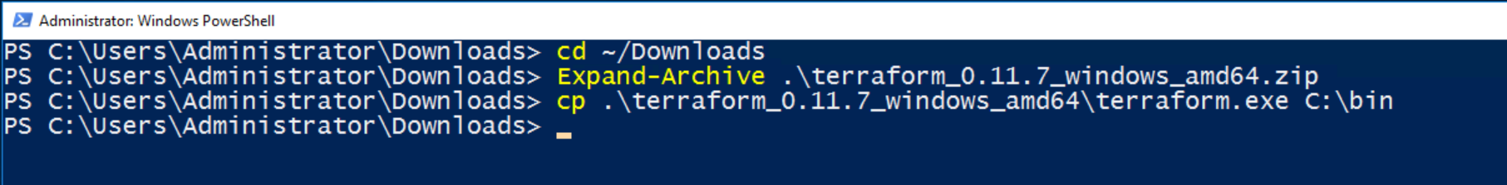
Step 3: Unzip and copy into the bin directory
Hint: Use <TAB> completion to type fewer keystrokes.
Notes:
Make sure and download the 64 bit version for Windows. Terraform is shipped as a single binary, inside of a zip archive.

Slide 24
Step 3: Unzip and copy into the bin directory
Hint: Use <TAB> completion to type fewer keystrokes.
Notes:
Make sure and download the 64 bit version for Windows. Terraform is shipped as a single binary, inside of a zip archive.

Slide 25
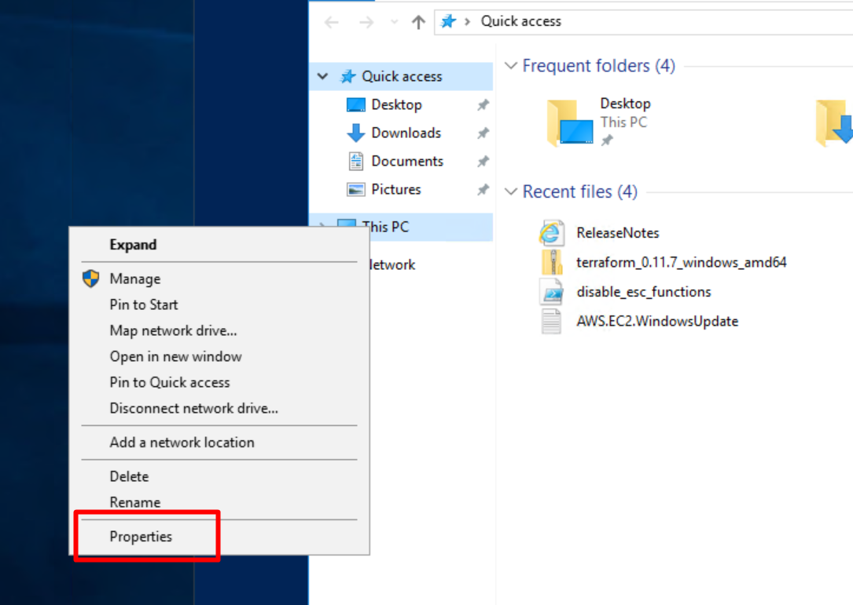
Step 4: Add C:\bin to your system path
Notes:
Open a file explorer and right click on “This PC” to get this menu. Select “Properties”

Slide 26
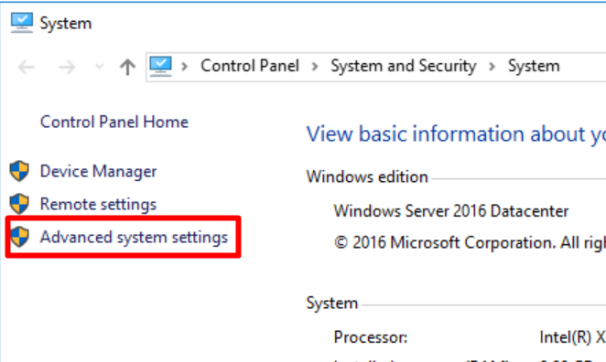
Step 4: Add C:\bin to your system path
Notes:
Select “Advanced System Settings”

Slide 27
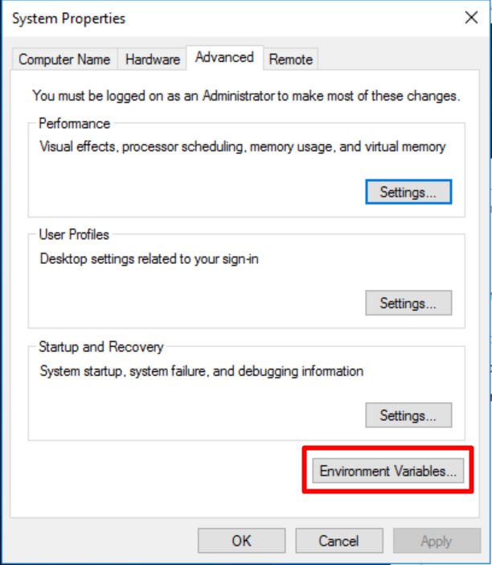
Step 4: Add C:\bin to your system path
Notes:
Select “Environment Variables”

Slide 28
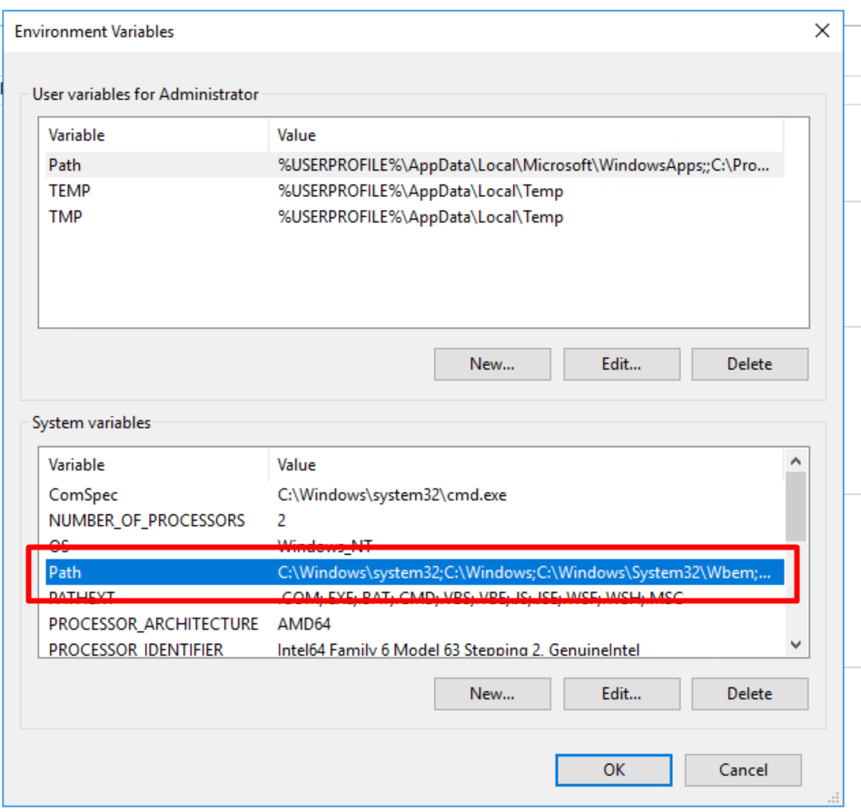
Step 4: Add C:\bin to your system path
Notes:
Select the “Path” variable under System Variables

Slide 29
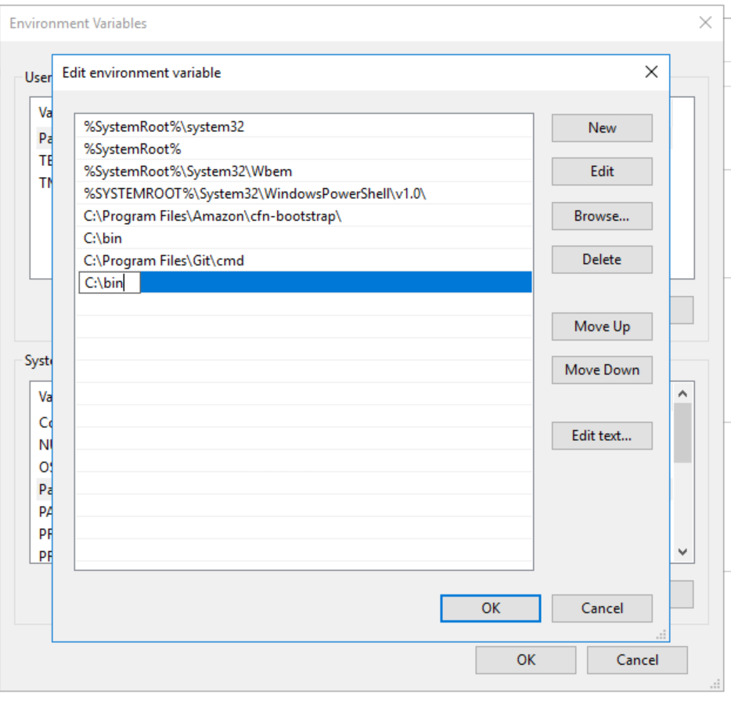
Step 4: Add C:\bin to your system path
Notes:
Use the “New” button to create a C:\bin entry in your path. This allows Terraform to be run from any powershell prompt.

Slide 30
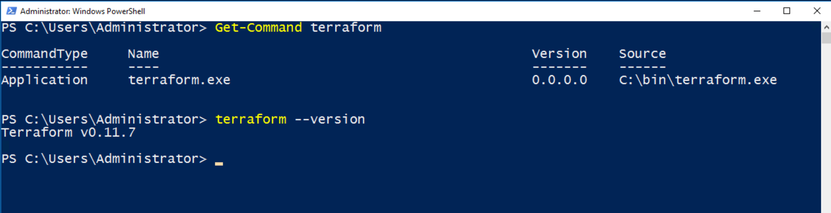
Test Your Work
Notes:
Run ‘Get-Command terraform’ and ‘terraform version’ to verify it’s installed and working.

Slide 31
Exercise: Install Visual Studio Code
Download Visual Studio Code
Install Git (optional)
Install the Terraform and Azure Terraform plugins

Slide 32
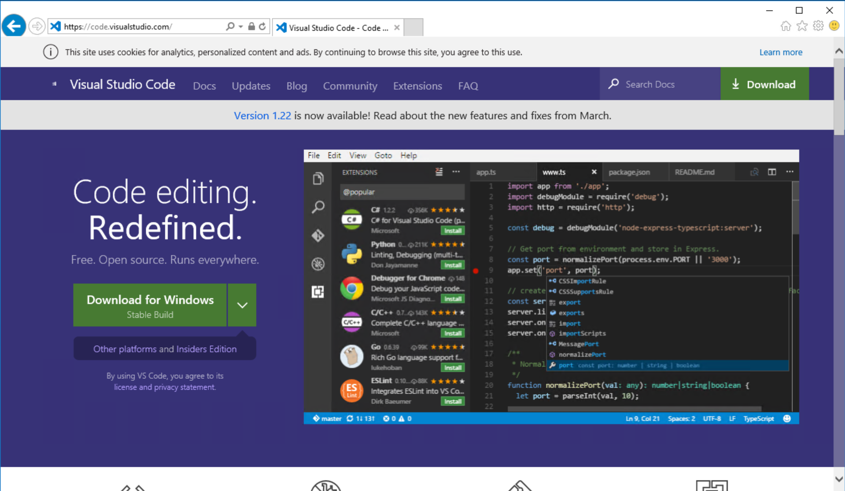
Step 1: Download and Install Visual Studio Code
code.visualstudio.com
Notes:
Make sure and download the 64 bit version for Windows. Terraform is shipped as a single binary, inside of a zip archive.

Slide 33
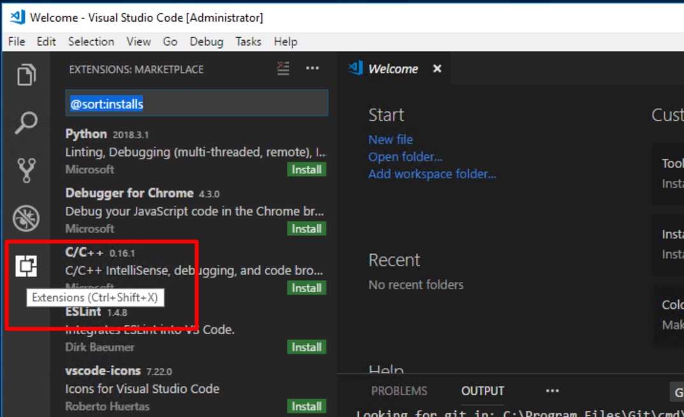
Step 2: Install VSC Terraform Extensions

Slide 34
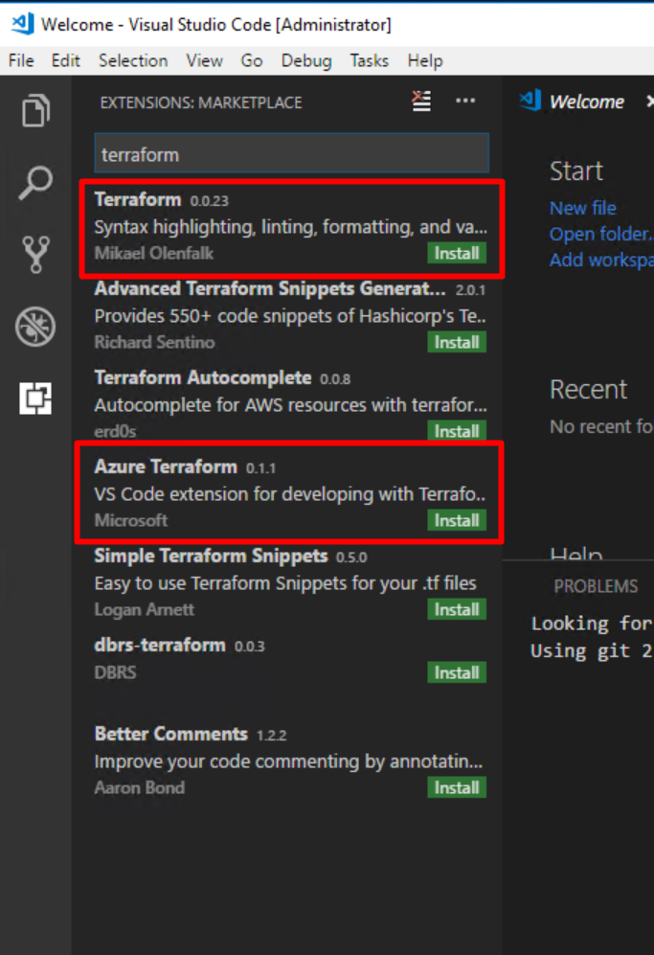
Step 3: Install VSC Terraform Extensions
Notes:
Search for ‘terraform’ in the extensions marketplace. Install both the Terraform and Azure Terraform extensions. Restart VSC or reload your extensions.

Slide 35
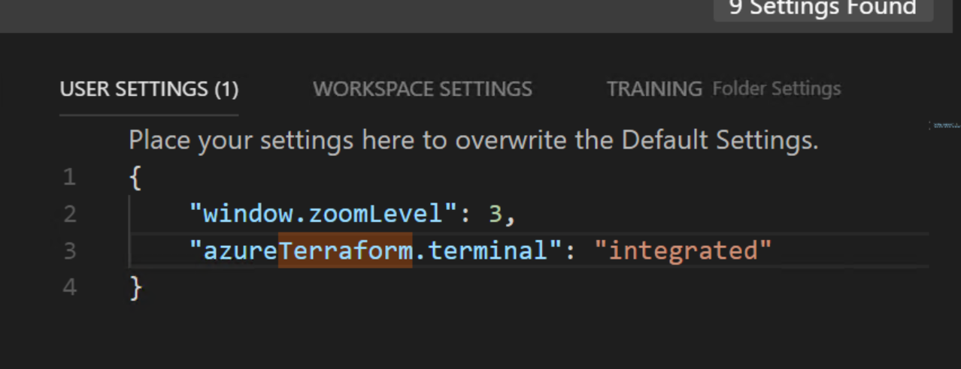
Step 4: Configure your Terminal
Select File >> Preferences >> Settings
Make your settings look like this:
Notes:
Cloudshell is kind of cool but this seems simpler and more straightforward. Valid options here are ‘integrated’ and ‘cloudshell’. If you use the local shell you can use the CTRL-SHIFT-P shortcut to run Azure Terraform commands.

Slide 36
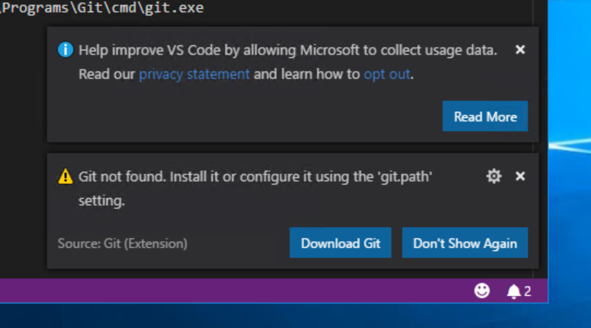
Optional: Install Git for Windows
Notes:
Make sure and download the 64 bit version for Windows. Terraform is shipped as a single binary, inside of a zip archive.

Slide 37
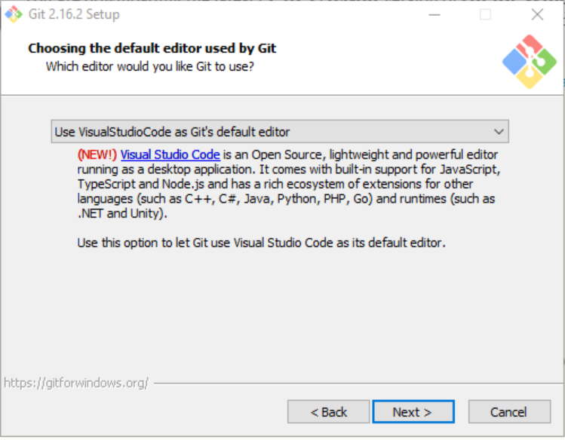
Optional: Install Git for Windows
Notes:
This is the only option you will need to change from defaults. Much nicer to use VSC as your git editor instead of nano or whatever.

Slide 38
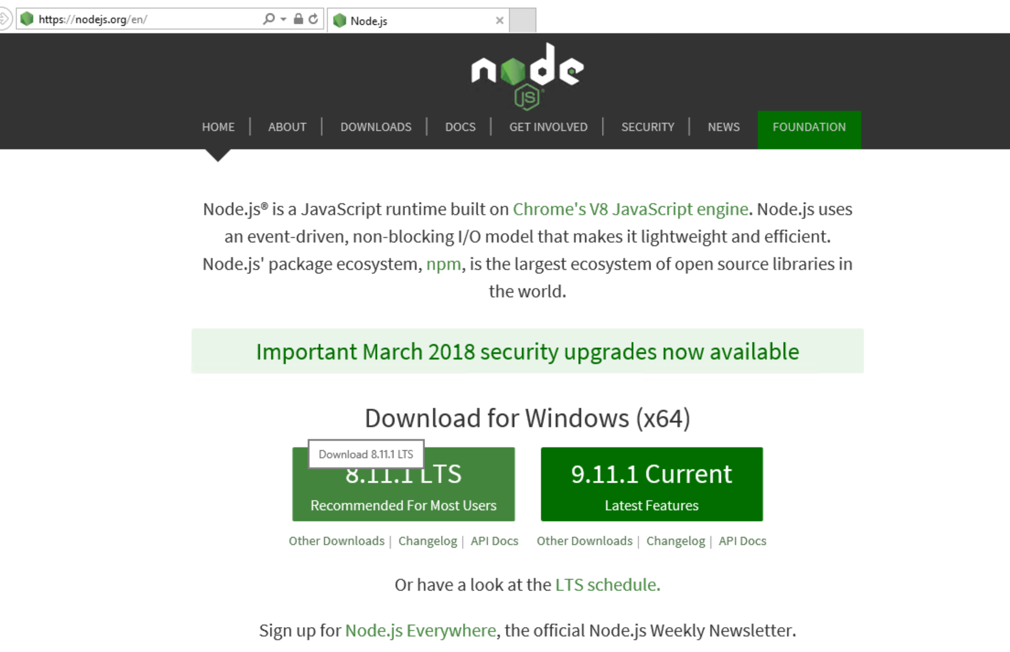
Optional: Install Node.js to enable Cloud Shell
Notes:
This lets you use Cloud shell right inside VSC. Slick. Not required.

Slide 39
Exercise: Install the Azure CLI
Download the Azure CLI MSI installer: https://bit.ly/2EU4gcX
In Visual Studio Code, open Terminal. CTRL-J will pop up the console/debug panel.
Run `az login` at the command prompt
Notes:
Worth pointing out here that you can stay completely within VSC and use the built-in Terminal for all your powershell.

Slide 40
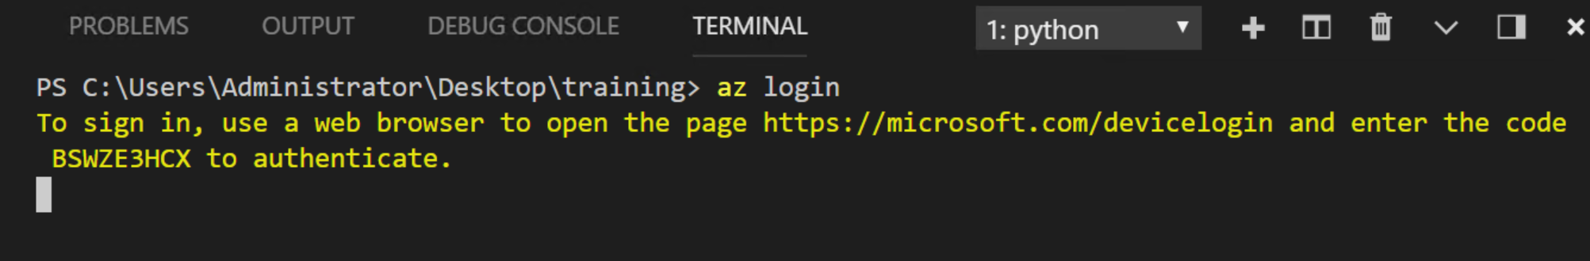
Exercise: Log onto Azure
Notes:
You’ll obviously require a valid subscription and login to do this step.

Slide 41
Exercise: Create a Workspace
Create a directory on your desktop called training
Right-click the training directory and select ‘Open with Code’
Select ‘File’ > ‘Save Workspace As’ and name it my_workspace
Notes:
Now you can come back to your project at any time. Just double-click the ‘my_workspace’ icon on the desktop.

Slide 42
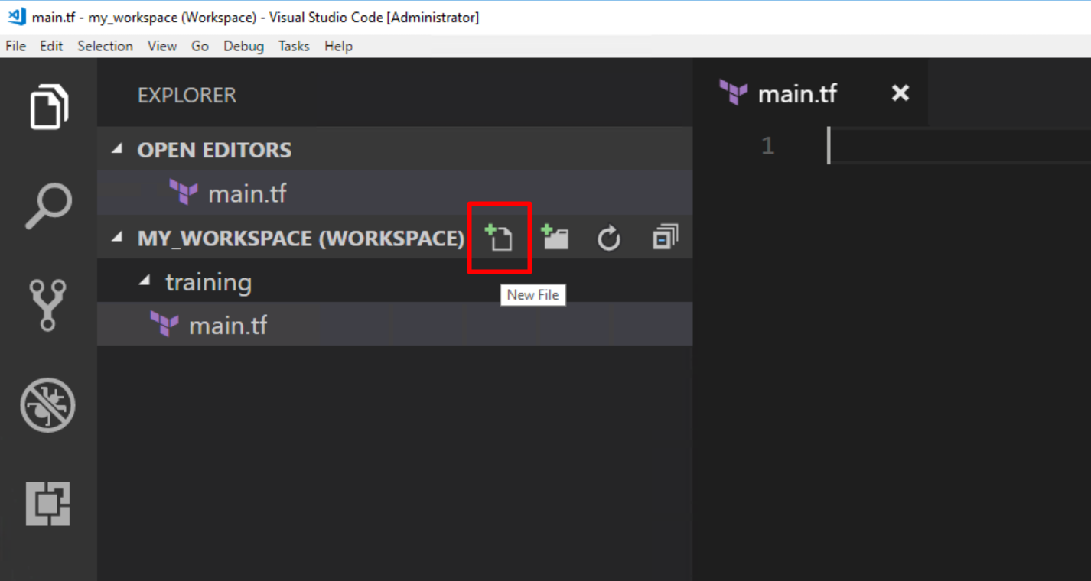
Exercise: Create a file called main.tf
Notes:
You can do everything you need from within VSC, including creating and deleting files.

Slide 43
main.tf
resource "azurerm_resource_group" "myfirstrg" {
name = "myfirstresourcegroup"
location = "East US"
}
Notes:
Make your main.tf file look like this. Try making a typo on purpose (or by mistake). Notice how the terraform plugin will catch it and correct you.

Slide 44
Group Lab
Terraform Init
Terraform Plan
Terraform Apply

Slide 45
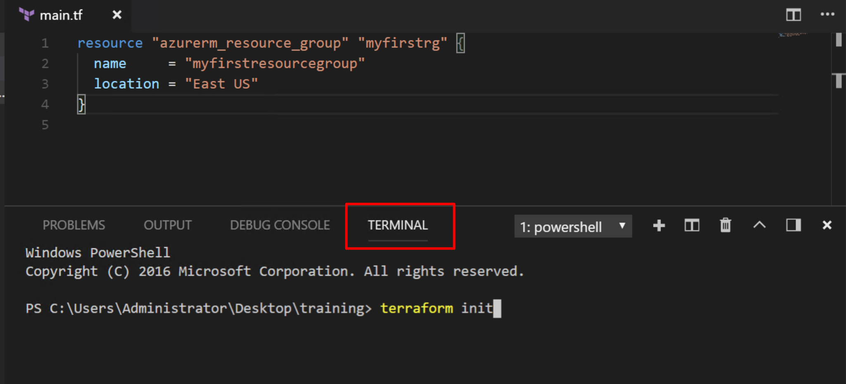
Exercise: Open a Powershell Terminal in VSC
Notes:
Use CTRL-J to pop open the debug console and terminal. Now you don’t have to leave VSC for anything!

Slide 46
Exercise: Run terraform init
Run the terraform init command to download the required providers.

Slide 47
$ terraform init
Initializing provider plugins...
Checking for available provider plugins on http://release…
- Downloading plugin for provider "azurerm" (0.3.3)...
The following providers do not have any version constraints in configuration,so the latest version was installed.
To prevent automatic upgrades to new major versions that may contain breakingchanges, it is recommended to add version = "..." constraints to thecorresponding provider blocks in configuration, with the constraint stringssuggested below.
provider.azurerm: version = "~> 0.3”
Terraform has been successfully initialized!

Slide 48
Terraform Init
You must run terraform init after adding or removing providers.
You do not need to run terraform init before each command.
Similar to git init.

Slide 49
Exercise: Run terraform help
Run terraform help to generate the full list of Terraform commands.

Slide 50
$ terraform help
Common commands:
apply Builds or changes infrastructure
console Interactive console for Terraform interpolations
destroy Destroy Terraform-managed infrastructure
env Workspace management
fmt Rewrites config files to canonical format
get Download and install modules for the configuration
graph Create a visual graph of Terraform resources
import Import existing infrastructure into Terraform
init Initialize a Terraform working directory
output Read an output from a state file
plan Generate and show an execution plan
providers Prints a tree of the providers used in the config
push Upload this Terraform module to Atlas to run
refresh Update local state file against real resources
show Inspect Terraform state or plan
taint Manually mark a resource for recreation

Slide 51
$ terraform help
Common commands:
apply Builds or changes infrastructure
console Interactive console for Terraform interpolations
destroy Destroy Terraform-managed infrastructure
env Workspace management
fmt Rewrites config files to canonical format
get Download and install modules for the configuration
graph Create a visual graph of Terraform resources
import Import existing infrastructure into Terraform
init Initialize a Terraform working directory
output Read an output from a state file
plan Generate and show an execution plan
providers Prints a tree of the providers used in the config
push Upload this Terraform module to Atlas to run
refresh Update local state file against real resources
show Inspect Terraform state or plan
taint Manually mark a resource for recreation

Slide 52
Command: terraform plan
The plan shows you what will happen
You can save plans to guarantee what will happen
Plans show reasons for certain actions (such as re-create)
Prior to Terraform, users had to guess change ordering, parallelization, and rollout effect

Slide 53
Command: terraform plan
+ indicates a resource will be created
- indicates a resource will be destroyed
~ indicates a resource will be updated in-place
-/+ indicates a resources will be destroyed and re-created

Slide 54
Exercise: Run terraform plan
Run terraform plan on the Terraform files created in the previous section. Leave the output on the screen for the instructor to see.

Slide 55
$ terraform plan
+ azurerm_resource_group.myfirstrg
id: <computed>
location: "eastus"
name: "myfirstresourcegroup"
tags.%: <computed>
Plan: 1 to add, 0 to change, 0 to destroy.

Slide 56
Command: terraform apply
Executes changes in order based on the resource graph
Parallelizes changes when possible
Handles and recovers transient errors
Notes:
The next step in performing changes with Terraform is to perform the Terraform apply. The apply is when the infrastructure operations are actually performed.
Using the resource graph defined by our configuration, Terraform determines the order in which to perform our changes, parallelizes the change when possible, and will handle known timing and transient errors when it can.
As an example, for a more complex configuration, Terraform can create EC2 instances that have no dependencies in parallel and will handle provider errors such as checking for the existence of an instance that was just created, as can happen when making fast changes.

Slide 57
$ terraform apply
azurerm_resource_group.myfirstrg: Creating...
location: "" => "eastus"
name: "" => "myfirstresourcegroup"
tags.%: "" => "<computed>”
azurerm_resource_group.myfirstrg: Creation complete after 2s (ID: /subscription/resourceGroups/MyFirstResourceGroup)
Apply complete! Resources: 1 added, 0 changed, 0 destroyed.
Notes:
Here is some sample output.

Slide 58
Command: terraform apply
Updates existing resources when updates are allowed
Re-creates existing resources when updates are not allowed
Notes:
An important note about Terraform, is that Terraform knows what changes it can apply to existing resources and what changes require that a resource is re-created - meaning a new resource will be created and the previous resource will be destroyed.
It is important to use the Terraform plan to know when these scenarios will occur to anticipate, and account for, potential service interruptions.

Slide 59
Individual Challenge!
Navigate to terraform.io/docs/providers/azurerm/index.html
Find the azurerm_resource_group
Add a tag to your resource group called “Production”
Ask for help! (neighbour, colleague, phone a friend, instructor)

Slide 60
main.tf
resource "azurerm_resource_group" “myfirstrg” {
name = ”myfirstresourcegroup"
location = ”East US”
tags {
environment = "Production"
}
}

Slide 61
$ terraform plan
-/+ azurerm_resource_group.myfirstrg (new resource required)
id: "/subscriptions/sresourceGroups/MyFirstResourceGroup" => <computed> (forces new resource)
location: "eastus" => "eastus"
name: "MyFirstResourceGroup" => "myfirstresourcegroup" (forces new resource)
tags.%: "0" => "1"
tags.environment: "" => "Production”
Plan: 1 to add, 0 to change, 1 to destroy.

Slide 62
$ terraform apply
azurerm_resource_group.myfirstrg: Destroying... (ID: /subscription/resourceGroups/MyFirstResourceGroup)
location: "" => "eastus"
name: "" => "myfirstresourcegroup"
tags.%: "" => "1"
tags.environment: "" => "Production"
azurerm_resource_group.myfirstrg: Creation complete after 1s (ID: /subscriptions/resourceGroups/myfirstresourcegroup)
Apply complete! Resources: 1 added, 0 changed, 1 destroyed.
Notes:
Here is some sample output.

Slide 63
Accomplished
Introduction to Infrastructure as Code
Learned what an Azure Resource Group is
Provisioned our First Resource Group to Azure

Slide 64
Quiz
What is an Azure Resource Group?
What is Infrastructure as Code?
What are the two Terraform commands and how do they differ?
What command allows you to format Terraform Code?

Slide 65
Questions?

